Slide 1


2023 Northeast AD HUB Refresher

Slide 2
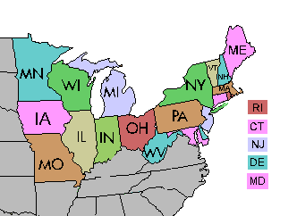
Introduction:
The Eastern Region operates under a four Hub Program to balance workloads across the geographical area. The Hiring Officials from each Hub have all discretion in hiring ADs based on Eastern Regional needs and administrative workload, and the casuals’ past performance and availability. They do not guarantee sponsorship, employment, or assignments.

Slide 3
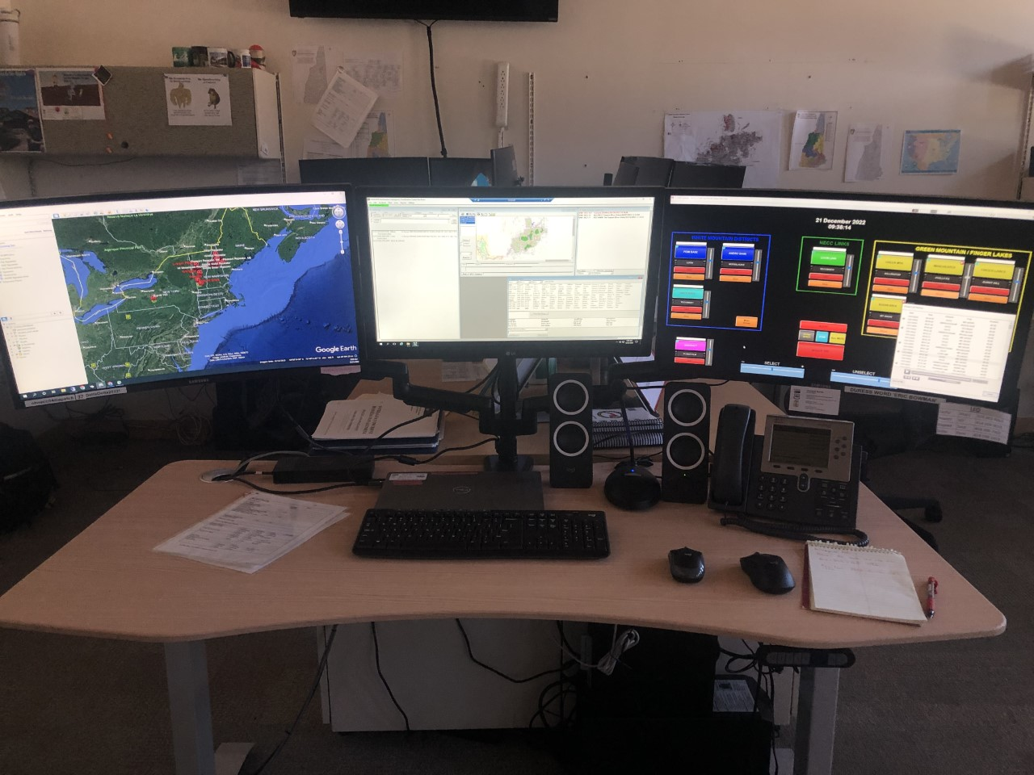
Administration:
Correspondence with the Northeast Hub AD Administrators can be made using the following:
Email: nhnecc@firenet.gov
Call NECC at 603-536-6208

Slide 4
Definitions:
Hiring Official:
Sponsoring Official:
Hiring Officials are delegated by Forest Supervisor of the White Mountain NF
At NECC these individuals are Lisa Spiess and Gareth Weaver
ROLES AND RESPONSIBILITIES:
Signs your Casual Hire Form
Submits initial hiring documents
Processes time and travel reimbursements
This person is your agencies' Duty Officer or Fire Manager
Additional administrative help may be delegated
ROLES AND RESPONSIBILITIES:
Approves Sponsorship Application Form annually
Approves availability status change requests
Responsible for activities such as training, WCT, IQS or IQCS, refreshers, etc.

Slide 5
Ch ch ch ch changes!
100% Digital
Pinyon upload access-INBOX
NECC disseminating and tracking forms for all ADs
Availability Process-Microsoft Form

Slide 6

Annual Onboarding Flow:
Submit the Sponsorship Application Form to your Sponsoring Official
Sponsoring Official will either approve or deny your sponsorship
If approved, Sponsorship Application Form will be sent to NECC
NECC will check your records and send you all required forms, guides & links
Individual AD will complete and upload required documents into Pinyon/Box
NECC will review for accuracy and work with AD till complete

Slide 7
Completing Your AD Paperwork
In 2022 NECC, with help from our agency partners, processed paperwork for 183 AD’s.
It is extremely time consuming for everyone involved.
Follow the guides provided with your annual packet to fill out and correctly name your documents. Attention to detail will save us all time and effort.
Incorrectly filled out forms will not be accepted.

Slide 8

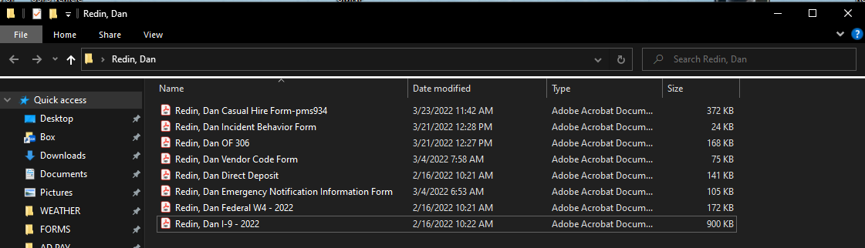
Once you have completed all of your AD paperwork create a folder with your name on it.
Save each individual PDF into the folder that you created.

Slide 9
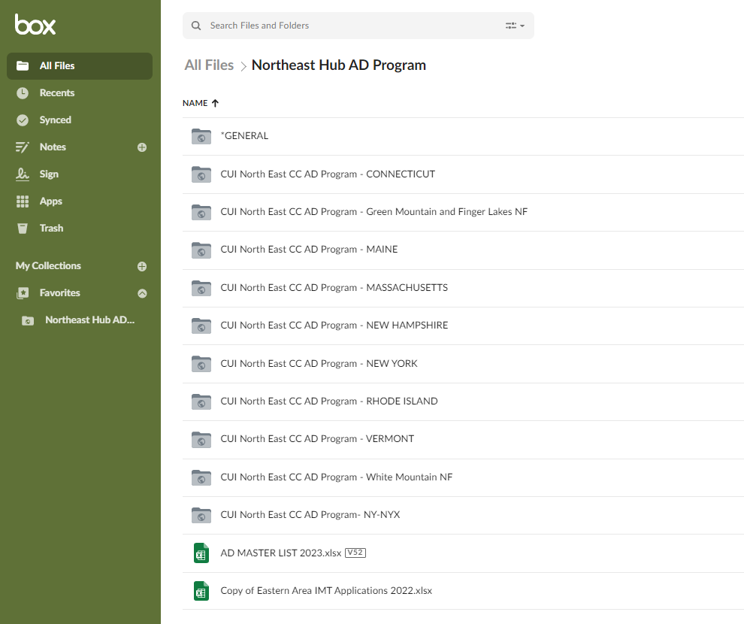
The Pinyon/Box Data Management System:
Pinyon is NECC’s digital file management system.
This process is a more secure method of transferring
your personal information than doing it via email.
Access to your personal information is limited to Hiring Officials, your Sponsoring Official(s) and the Northeast AD HUB administrators.

Slide 10
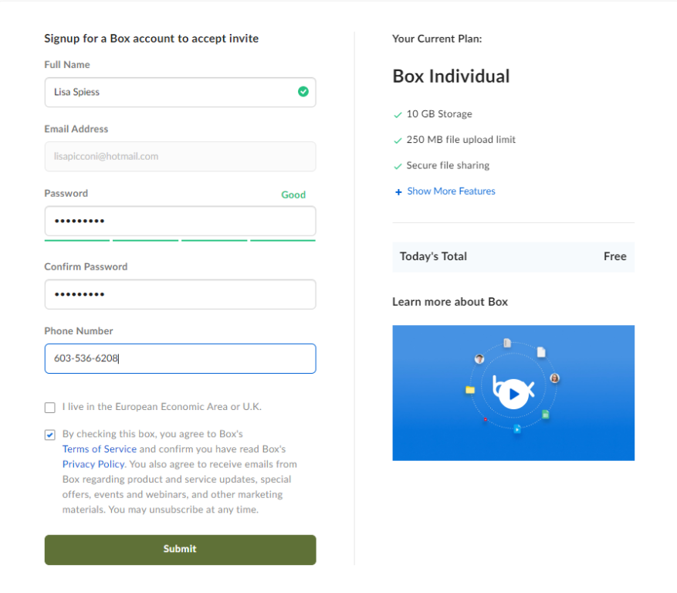
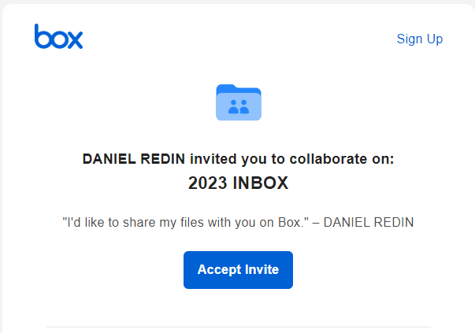

Uploading to Pinyon/Box - reference Job Aid
NECC will give you upload only privileges to the Pinyon/Box Inbox for your agency once we have received your approved Sponsorship Letter. You will receive a link to the inbox through your email. Accept the invite and register.

Slide 11
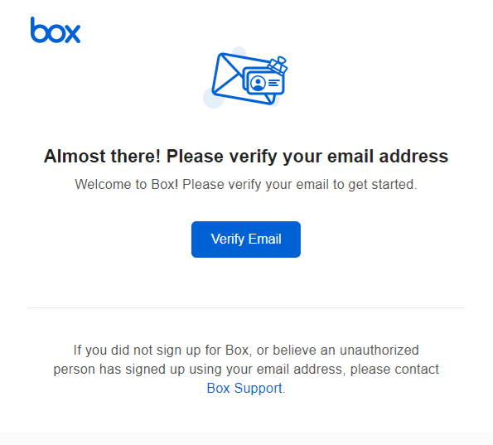
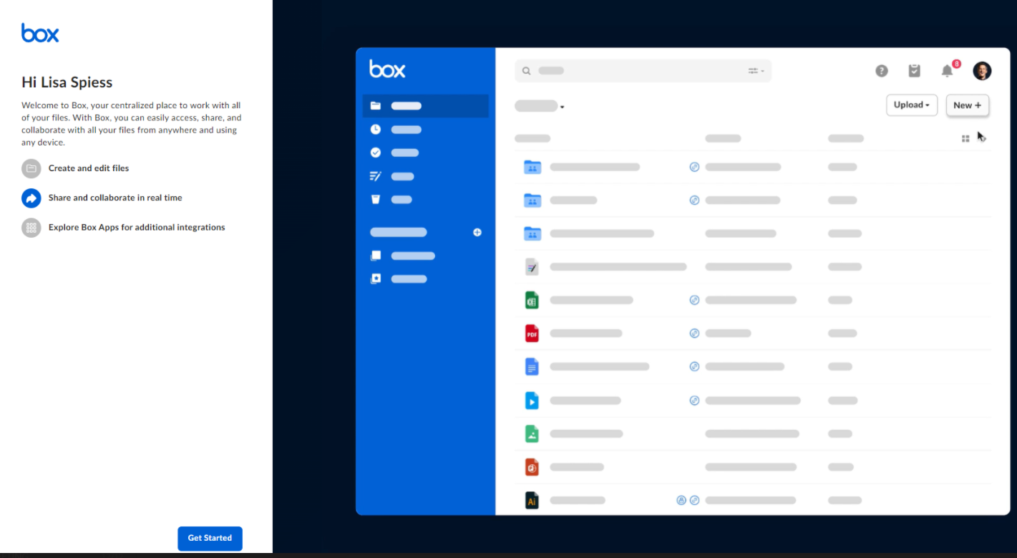
Uploading to Pinyon/Box - reference Job Aid
You will receive a verification email, click the link to verify your account.
Hit the get started button to proceed

Slide 12
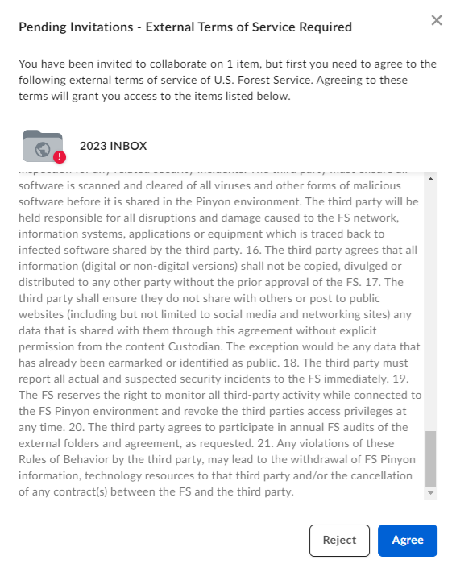
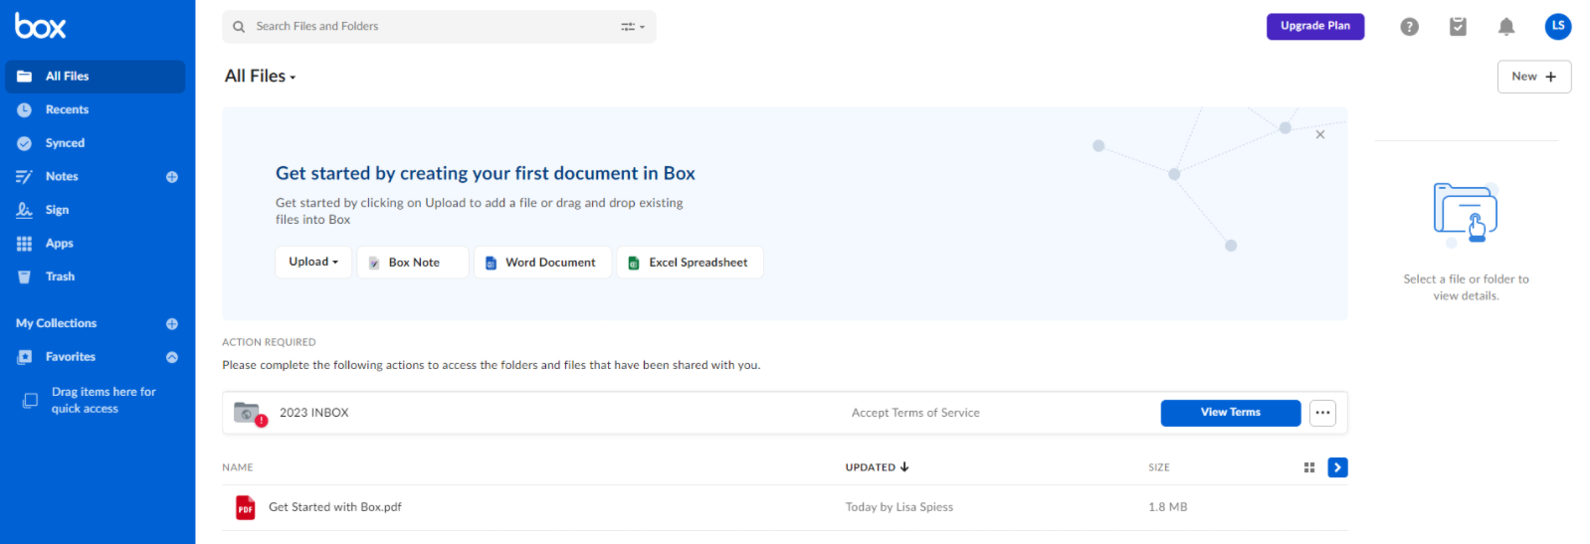
Uploading to Pinyon/Box - reference Job Aid
Click view terms and click agree to access the inbox.

Slide 13
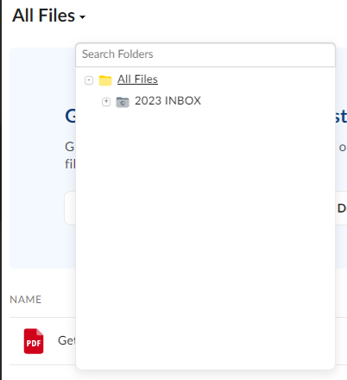
Uploading to Pinyon/Box - reference Job Aid
You can now see the folders that you have access to in Pinyon/Box. Click on All Files and select the 2023 INBOX.

Slide 14
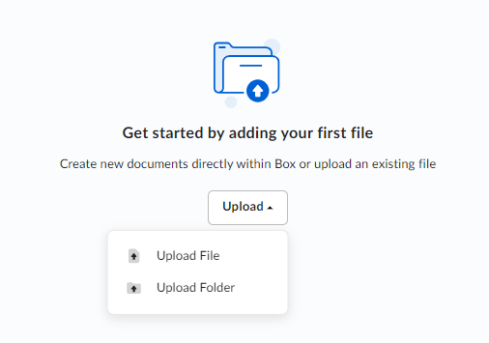
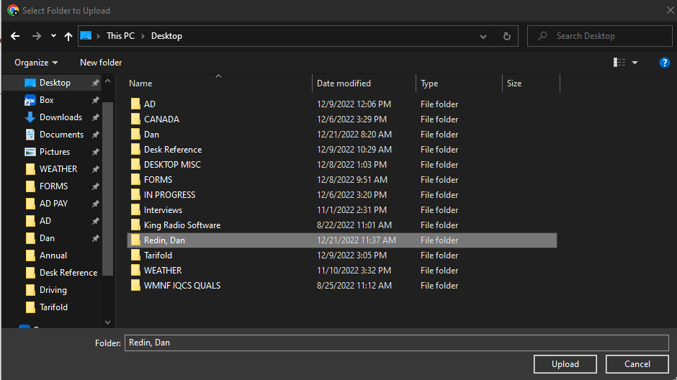
Highlight the folder containing your AD files and click upload.
Click the Upload button and select the Upload Folder option in the dropdown.

Slide 15
Uploading to Pinyon/Box - reference Job Aid
That is it!
Your files are now in the Pinyon/Box database. NECC will receive a notification that the upload has occurred. We will audit and file the completed forms in your personnel file and return any that have issues and need corrections.

Slide 16

Break Time!

Slide 17
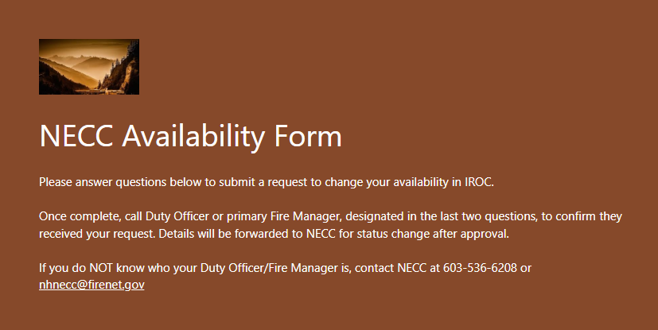
Availability:
Availability requests may be submitted by either a Duty Officer/Fire Manager or by a single resource.
An availability request is required any time a resource would like to change their status from unavailable to available in IROC.
In an effort to streamline operations and make the process more user friendly, NECC is now using an online availability form that is usable on both desktops and mobile devices.
It contains several required fields for all availability requests and also has some additional fields to include rosters for grouped resources.

Slide 18
Availability: Flow
This is an automated process that triggers multiple notifications .
When you as the resource submits the form, it will send an approval request to your Duty Officer/Fire Manager based on the email address provided in the last question on the Form. They will have the option to approve or deny the availability request.
The information gets forwarded to NECC with the Duty Officer/Fire Managers response.
NECC will set resource availability if approved.

Slide 19
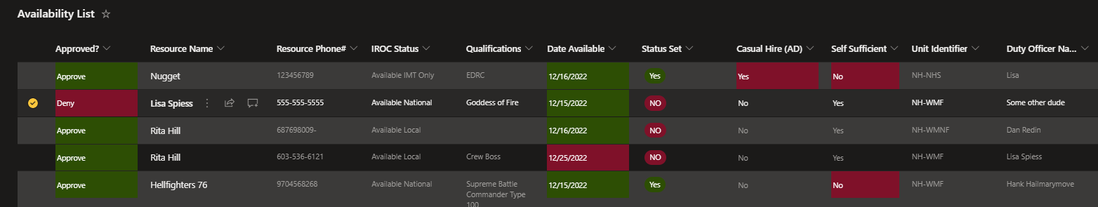
Availability:
NEW FEATURE OF ONLINE FORM:
You can now request to go available in advance of the date needed. Previously NECC did not have a reliable way to track availability to make it possible to schedule ahead of time. Availability submissions will now populate to a table that sets reminders to complete tasks.
**Remember that going available does not mean you will get assignment immediately, and minimum 14 days for assignment is standard**

Slide 20
Availability: Fields on the form (*required field)
*Name of Resource Being Statused- Your name
*Resource Contact Number- A phone number that can reach you at any time (cell phone)
Qualification(s) you want visible: List only qualifications you want to have active, if none listed all will be left visible
Engine or Crew- Should include any rostered individual resources with qualifications (For engines, crews, modules)
Engine or Crew Boss & Phone Number- Primary point of contact for all communications on rosters and mobilization.
*Home Unit Identifier- EX: NH-WMF, CT-CTS. This tells NECC who the resource works for
*Availability Status Area- Local, Geographic Area, State, National, IMT Only, Virtual Only (Name Requests are statused as Local)
*Date of Status Change- Date you want availability status to change
*Is a Casual Hire being statused- Prompts NECC staff to create a Casual Hire Form for the AD(s)
*Is Resource Self Sufficient- Can resource support themselve(s) for up to 72 hours?
Direct Supervisor Name and Number- For ADs this will be the same as your Sponsoring Official
*Duty Officer/Fire Manager Name- This is the person that approves your availability from your home unit
*Duty Officer/Fire Manager email- This field should only contain an email address. This is where the form is sent when submitted

Slide 21
Availability:
When a change is made to a resource's availability NECC will send an email notification to both the resource and the approving Duty Officer/Fire Manager confirming that the change has been made.

Slide 22
Availability Area:
This question is often answered incorrectly. There are 7 availability options to choose from:
Available Local- Should be used if available for local requests or if expecting a named request
Available GACC- This means that you only want to be available in your local geographical area (Eastern Area)
Available State- In your state only
Available National- You can be requested to go anywhere nationwide
Available IMT Only- For members of one of the Incident Management Teams, they will only get IMT requests
Available Virtually Only- Virtual assignments only
Unavailable- To remove a resource from being available

Slide 23

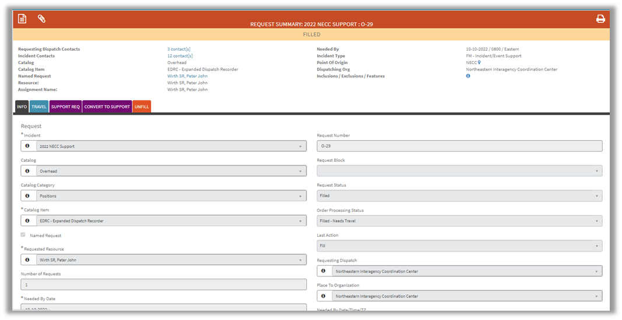

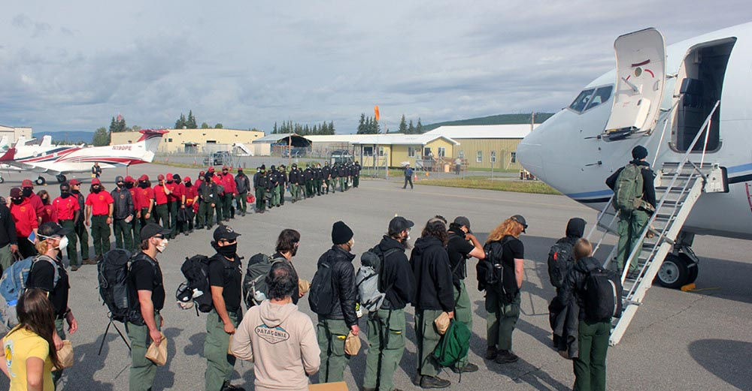



Mobilization: Flow
NECC fills Request with available Resource
NECC assists with securing travel logistics (flights, rental vehicles, ground support)
Resource Request comes to NECC
Resource(s) Mobilizes to Incident

Slide 24
Mobilization: Tips
DO NOT mobilize without a Casual Hire Form
POV mileage, covers trip to the airport for mobilization, not return mileage if being dropped off
Make sure you have needed forms (most up to date)
If you will be using government computer(s), make sure you have taken internet security training and have active FireNet Account and access if supporting Dispatch or IMT
Track with NECC until arrival at incident, then track with Incident Dispatch. Provide RON locations and inform NECC of deviation from planned itinerary so we can document

Slide 25
Demobilization:
Make sure you complete the DEMOB PROCESS and provide travel details to Incident Dispatch BEFORE you leave assignment.
IF CREW, notify NECC of Demob in advance so we can assist coordination of logistics upon return.
Get Timesheet signed at incident, by direct supervisor or Finance Section.
Have PERFORMANCE EVALUATION completed by appropriate incident supervisor.
Required for all ADs.
When you return home from assignment, inform NECC via phone or email.
Please do not call outside of business hours unless there is an emergency.
NOTIFY NECC IMMEDIATELY OF EMERGENCY DEMOBILIZATION

Slide 26
Who submits NERV Paperwork?
YOU
For details, visit the NERV website: https://nerv.firenet.gov/

Slide 27
Reimbursement Process: what to submit
OF-288 Time Sheet – SIGNED
PMS-934 Casual Hire Form – SIGNED
Travel Worksheet
Receipts
Copy of Resource Order if lodging over per diem - letter if available
Image of mileage if claiming POV mileage
(google maps screenshot indicating distance, not picture of odometer)
Don’t Forget!
Evaluations required for every assignment

Slide 28
Reimbursement Process: 2 ways to process
Casual Pay – Incident Payment Center
ETS2 – Government Travel System
All OF-288s
All Travel, if none to the conditions listed to the right are present
Travel Only, IF...
Lodging over per diem
Training related travel
Rental Vehicle rented by AD
Misc reimbursements outside standard incident business allowables
Incident assignment OVER 30 days long
https://www.fs.usda.gov/sites/default/files/2022-05/2022usfscasualtravelpolicy.pdf
Once submitted, typically 5-7 days to process, unless National Preparedness Level is 4 or 5 and ASC has increased workload.
Setting up as Traveler in ETS2 takes 10-15 days from submission of Vender Code Form

Slide 29
Reimbursement Process:
Travel Worksheet Example

Slide 30
Incident Business Reminders
No AD Casual Hire shall mobilize to an incident or attend training without a completed and signed Casual Hire Form.
Paperwork from previous assignment must be completed and correct before going available for next assignment.
Show a lunch break on your Incident Time Report
Mandatory Trainings are reimbursable
You CAN submit your time at incident (get Batch Number or contact for who you submit to)
Reference Casual Hire policy as well as NWCG, Forest Service and Incident Business Management Guides as needed

Slide 31
Helpful Links
USDA Forest Service, Incident Business Practices Personnel: https://www.fs.usda.gov/managing-land/fire/ibp/personnel
Includes AD Pay Plan, Travel Policy and Guidance, ECI Report and additional helpful information for Casual Hires
FireNet Website: https://www.firenet.gov/
NERV Website: https://nerv.firenet.gov/
NWCG Standards for Interagency Incident Business Management: https://www.nwcg.gov/publications/902
GSA – Per Diem Rates: https://www.gsa.gov/travel/plan-book/per-diem-rates
Forest Service Fire and Aviation Qualification Guide: https://gacc.nifc.gov/rmcc/dispatch_centers/r2gjc/training/fsfaqg.pdf
Interagency Standards for Fire and Fire Aviation Operations: https://www.nifc.gov/standards/guides/red-book
Red Book
National Wildfire Coordinating Group (NWCG): https://www.nwcg.gov/
Northeast Forest Fire Protection Compact (NFFPC): https://www.nffpc.org/en/necc/about

